Slide 1
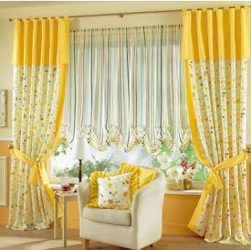

Slide 2
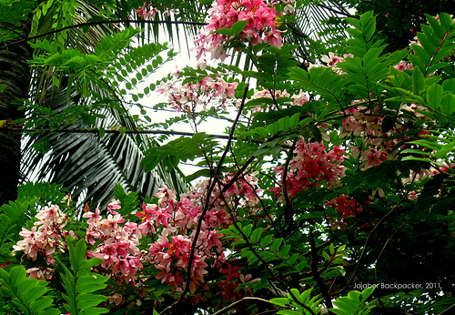
Welcome To My class Dear Students

Slide 3
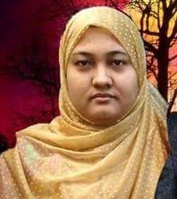
Introduction
Name:Rahima Khanam
Assistant Teacher(English)
Kachuria Secondary High School
Chitalmary, Bagerhat.

Slide 4
Lesson Introduction
English 2nd paper
Class: Nine( Writing Section)
Paragraph

Slide 5
Let’s see some picture

Slide 6
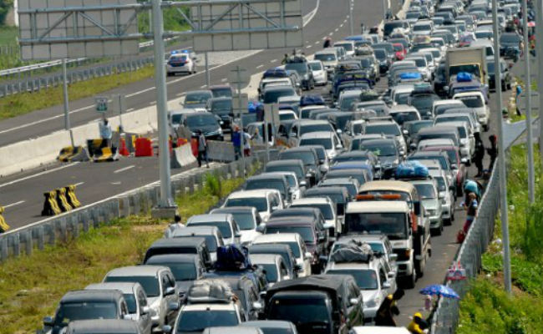
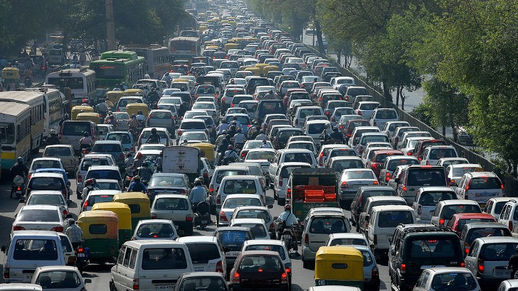
It’s a big line of vehicles
It is called traffic jam .
What is this?
What is it called?

Slide 7
Todays Our Lesson Is
Traffic Jam

Slide 8
Learning Outcomes
1.Ask and answer the question
2.Practice speaking and writing skill
3.Write a paragraph about “Traffic Jam”

Slide 9
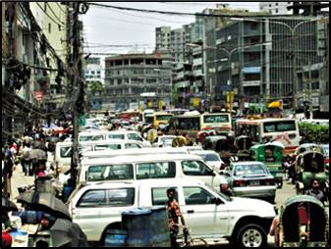
Traffic jam is a blocked of cars and vehicles on the road
what is traffic jam?

Slide 10
Where is it common affair?
It is common affair in big cities and towns.And it is mainly seen in Dhaka city.

Slide 11
Why does traffic jam occur?
The causes of traffic jam are many
They are

Slide 12
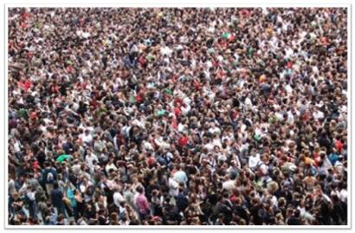
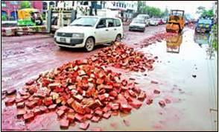
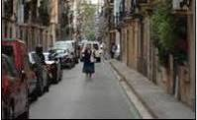
Over popoulation
Un planned construction
Illigal parking
Narrow road

Slide 13
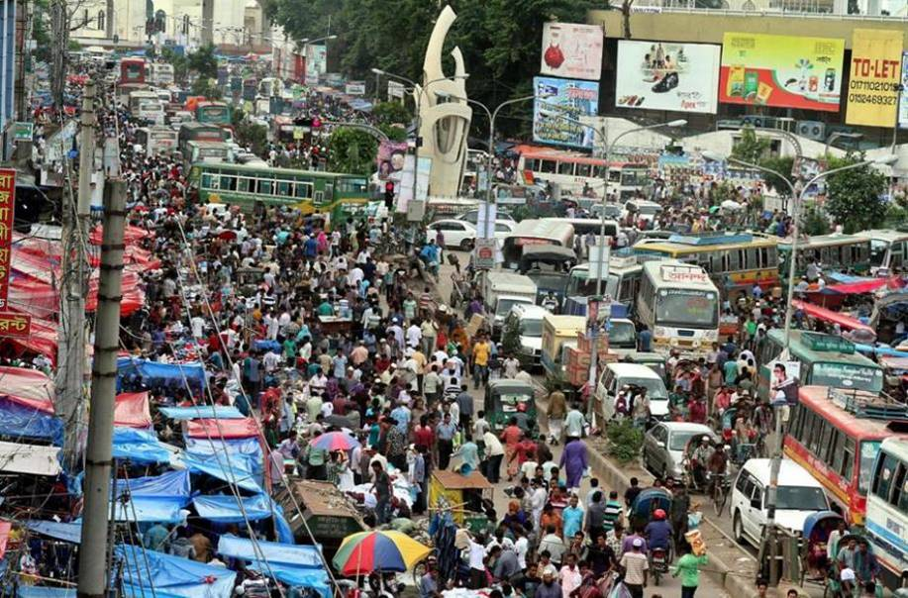
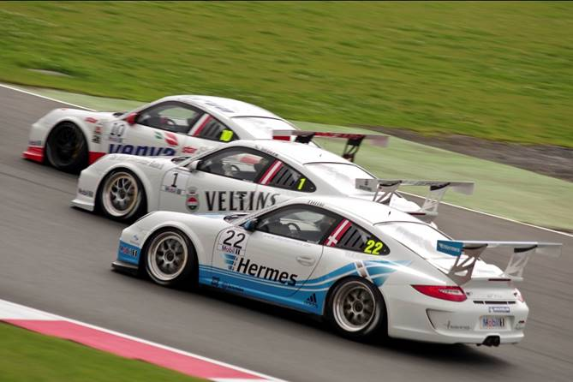
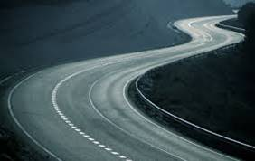
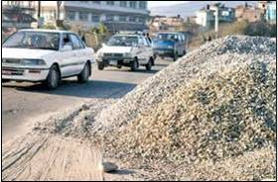
Illigal market on roads
Overtaking tendency
Zigzag roads
Keeping construction materials on roads

Slide 14
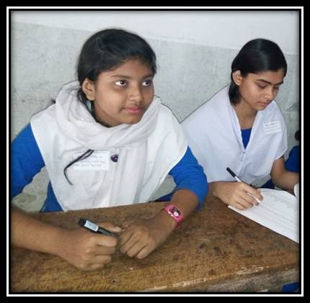
Pair work-5 m
Please write down the causes traffic jam

Slide 15
At a glance of the cause of traffic jam
=Over population
=Insufficient roads
=illigal parking
=keeping construction materials on roads
=Narrow roads
=Invalid cars and vehicles
=Unlicensed vehicles
=unplanned reparing
=invalid roads
=illigal market on roads
=insufficient traffic police
=irregular signal light
=overtaking tendency
=lack of by pass roads
=corruption of communication department

Slide 16
What problems are caused by it?
It causes many serious problems to the people.
Let’s see

Slide 17
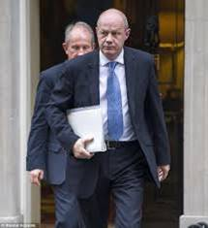
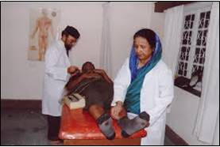
Officers can not go to the office in time
Doctors can not go to their chamber and hospitals in time

Slide 18
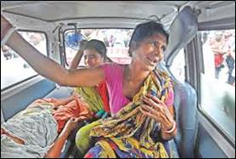
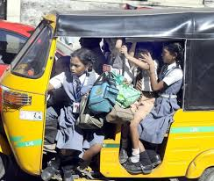
Patients can not go the hospital in time
Student can not go to school

Slide 19
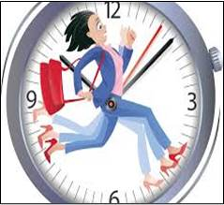
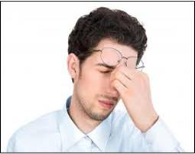
What is the effect of this problem?
It kills our valuable time and our works are hampered
Life become boring

Slide 20
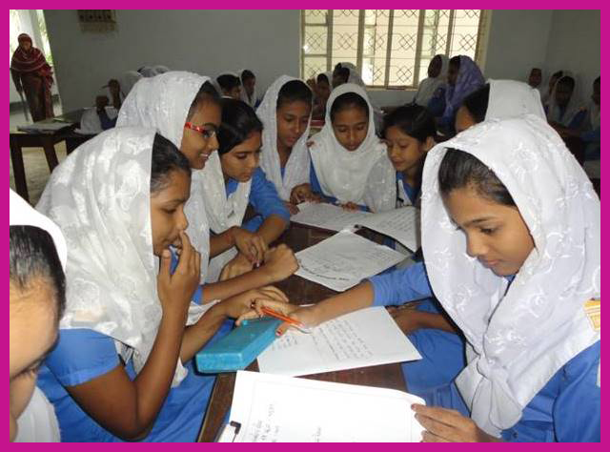
Group work-10
How can traffic jam be removed?

Slide 21
We should take some steps like as
1.Well planned spacious roads constructed.
2.Sufficient traffic police should be posted on important points.
3.Unlicenced vehicles should be removed.

Slide 22
Evaluation-5m
1.What is traffic jam?
2.Why does traffic jam occur?say 2 points.
3. What is your feeling at the time of traffic jam?
4. How can traffic jam be removed?

Slide 23
verse:
Life is more valuable than time.

Slide 24
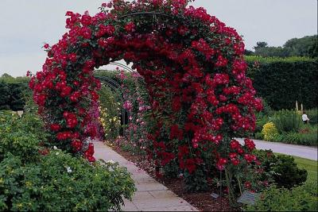
Thanks 2 all, Dear students.

